Slide 1
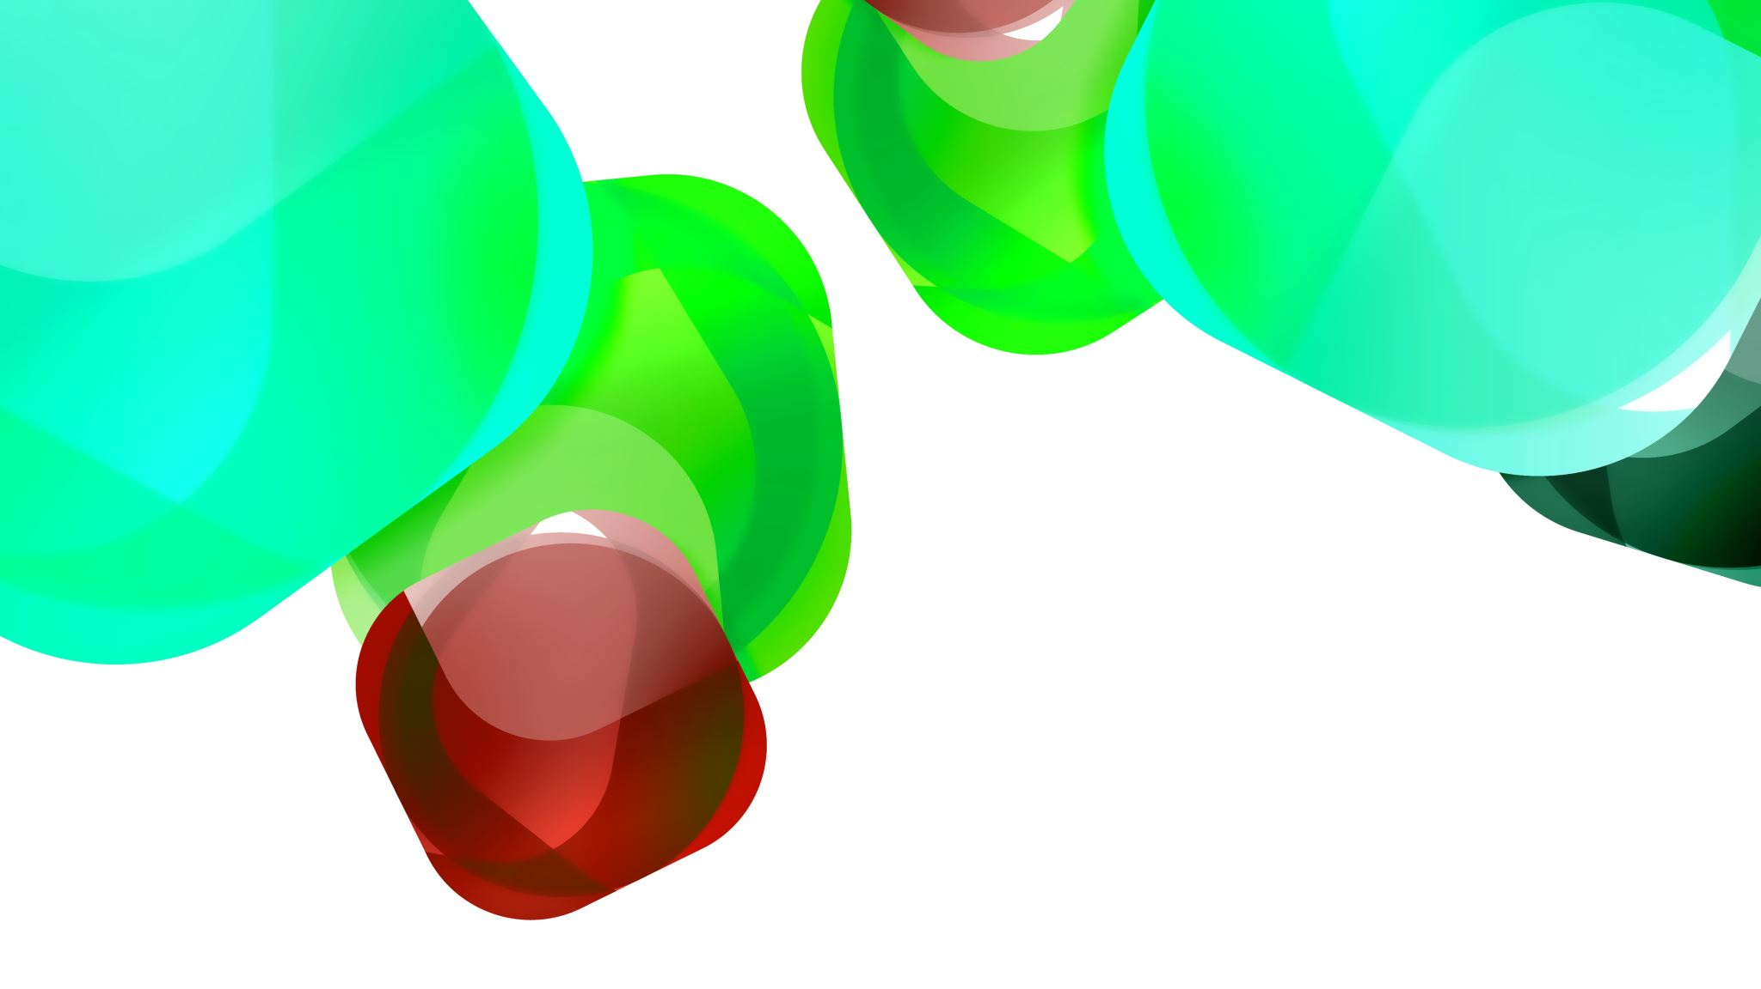
A System to classify an object of an RGB Image

Slide 2
My Team
Sasi Supraja Muthakana(A04314182)
Naga Venkata Vasudeva Rao Bodi(A04314290)
Harshita Papaiahgari(A04317038)
Sai Avinash Vagicherla (A04312707)
Venkata Siva Bharghav Guggilapu (A04324653)
Nithin Sampath Rohan Bheemavarapu (A04317338)

Slide 3

CONTENTS
Overview
Objective
Data Pre-processing
About CNN
The Architecture
Training
Training Loss
Calculations
Model Testing and Evaluation
Pros and Cons
Further Improvements

Slide 4

Overview
The project aims to create a system for categorizing objects in RGB images. The dataset comprises 9,999 RGB images, each with dimensions of 32x32x3. These images are associated with class labels, dividing them into ten distinct categories: airplane, cat, deer, frog, horse, ship, automobile, bird, dog, truck.

Slide 5

OBJECTIVE
Create a reliable classification system capable of precisely recognizing objects in RGB images. Employ a Convolutional Neural Network (CNN) structure to extract pertinent features and patterns from the images. Attain a substantial classification accuracy on the test dataset to showcase the system's resilience and efficacy.

Slide 6
Data Preprocessing
We are transforming the RGB image into grayscale.
Transform an RGB image into a grayscale image using the following steps:
Create an empty list to hold the grayscale images.
Go through each RGB image in the dataset.
Reshape each image to the dimensions 32x32x3.
Utilize a weighted sum method to convert the RGB image to grayscale.
Save the resulting grayscale images in the list.
Split the dataset into two subsets:
Training set (Dtrain) comprising 70% of the data.
Testing set (Dtest) comprising the remaining 30%.

Slide 7

About CNN
Convolutional Neural Networks (CNNs) constitute a category of deep neural networks explicitly crafted for the processing of structured grid-like data, particularly images.
Comprising layers like convolutional layers, pooling layers, and fully connected layers, CNNs excel in acquiring hierarchical representations of visual data, enabling the capture of intricate patterns and features within images.
These networks leverage specialized operations, including convolution, ReLU activation, and pooling, to extract and maintain crucial spatial information.
The impact of CNNs on computer vision and image recognition has been transformative, ushering in significant advancements across applications such as image classification, object detection, and image segmentation.

Slide 8
The Architecture
The CNN architecture consists of five convolutional layers, each succeeded by a ReLU activation function and a subsequent max pooling layer.
The number of filters within the convolutional layers progressively increases from 32 to 512. All convolutional layers employ a 3x3 kernel size with padding.
Following the convolutional layers, the network employs an adaptive average pooling layer to diminish spatial dimensions to 1x1.
The resulting output undergoes flattening and is then processed through two fully connected layers.
The initial fully connected layer comprises 512 neurons, accompanied by a subsequent ReLU activation function. The final layer consists of 10 neurons, aligning with the number of classes in the classification task.

Slide 9
The Architecture
Utilizing ReLU activation functions brings non-linearity into play, aiding the network in acquiring a grasp of intricate patterns.
The incorporation of max pooling layers serves to diminish spatial dimensions, effectively managing overfitting and lowering computational expenses.
Finally, the conclusive classification is executed by the fully connected layers at the end, leveraging the high-level features extracted by the preceding convolutional layers.

Slide 10
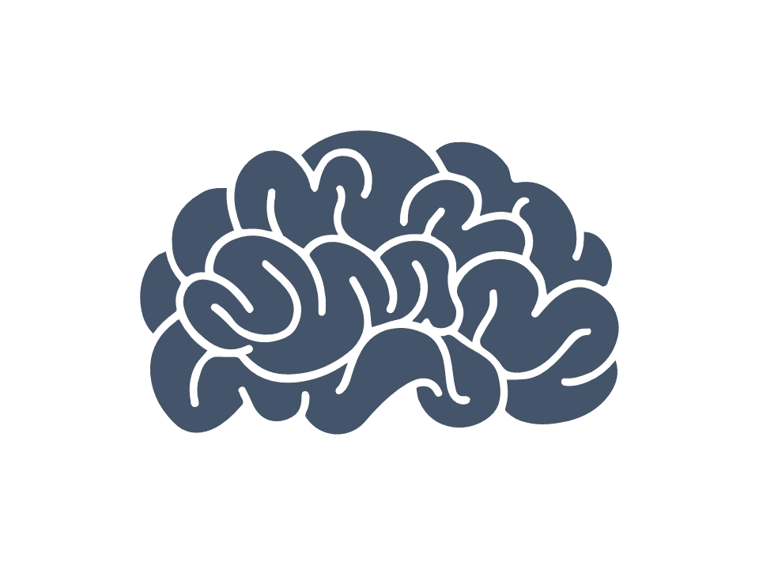
Functions
System Loss Function
Activation Function
Categorial Cross Entropy
ReLu (Rectified Linear Unit)

Slide 11
Training
Begin by setting up the CNN model and specifying the Cross Entropy Loss function.
Employ the Adam optimizer with a learning rate of 0.001 for the optimization process.
Iterate through the training data for a designated number of epochs. During each iteration, calculate the outputs and loss, execute backpropagation, and adjust the model parameters accordingly.
Keep track of the gradient norm, and conclude the training process if it descends below a predetermined threshold. Conclude the training phase by printing a message indicating its completion.

Slide 12
Training Loss
Training Loss Explanation:
Loss denotes the disparity or discrepancy between the model's predicted output and the true target labels within the training dataset. Minimizing this loss is paramount during training, as it indicates the model's proficiency in making precise predictions and adapting its parameters accordingly.
Significance of Monitoring Loss:
Observing the loss is crucial for evaluating the model's performance and convergence throughout the training phase. It provides insights into the effectiveness of the selected optimization algorithm and learning rate.

Slide 13
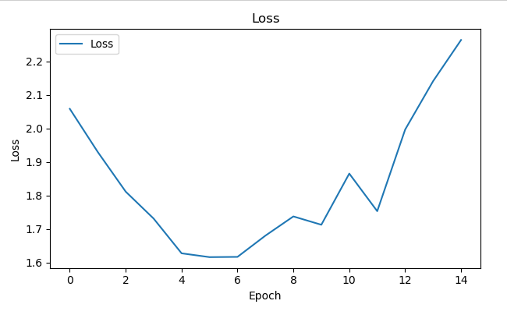
Calculating the Training Loss
The loss was determined through the application of the Cross Entropy Loss function, a standard choice for tasks involving multi-class classification. This computation of loss was performed individually for each batch of training data, and subsequently, an average was taken to track the comprehensive progress of the training.

Slide 14

Model Testing and Evaluations
The Accuracy of the model is 46%, when run for 15 epochs when 20% of the total training set was used for validation.

Slide 15

Pros
Effective Feature Extraction: Our model being a CNN, automatically learns hierarchical representations and features from images without the need for manual feature engineering. This capability is crucial for tasks where the relevant features are complex and multi-level.
Complex Architecture: The structure incorporates multiple convolutional layers, enabling the model to acquire intricate hierarchical features from the input information.
Utilization of Max Pooling: The integration of max pooling layers facilitates the down sampling of feature maps, aiding in the retention of crucial features while reducing spatial dimensions.
Adaptive Average Pooling: The adoption of adaptive average pooling before fully connected layers allows the model to handle input images of varying sizes.
Application of ReLU Activation: The consistent use of the ReLU activation function throughout the network accelerates convergence during training and mitigates challenges associated with the vanishing gradient problem.
Ample Model Capacity: With a substantial number of parameters and layers, the model possesses a considerable capacity to comprehend intricate patterns within the data.

Slide 16

Cons
Cons:
Complexity and Overfitting Concerns: The substantial model capacity may result in overfitting, particularly with limited datasets, unless appropriate regularization techniques are applied.
Computational Intensity: The extensive number of parameters and layers can impose significant computational demands, rendering training and inference computationally intensive, especially on devices with constrained resources.
Potential Gradient Issues: Deeper networks may encounter challenges such as vanishing or exploding gradient problems during training, potentially impeding convergence.
Limited Model Interpretability: Due to the intricate architecture, comprehending the internal mechanisms of the model and interpreting its decision-making process can be challenging, thereby limiting interpretability.
Hyperparameter Sensitivity: The architecture's performance may heavily rely on the selection of hyperparameters, including learning rate, batch size, and regularization. Consequently, extensive hyperparameter tuning becomes crucial for achieving optimal results.

Slide 17
Further Improvements
Learning Rate Scheduling: Explore various learning rate schedules, such as decay or cyclical learning rates, to identify an optimal strategy for faster convergence and enhanced generalization.
Hyperparameter Tuning: Conduct a thorough search for optimal hyperparameters, encompassing variables like learning rate, batch size, and regularization strength, to attain the highest model performance.
Data Augmentation: Apply techniques for data augmentation to enhance the diversity of the training data, promoting improved generalization of the model.
Regularization: Employ regularization methods like dropout or batch normalization to mitigate overfitting, enhancing the model's capability to generalize effectively to unseen data.
Model Ensemble: Consider creating an ensemble of models to merge multiple predictions, often resulting in improved generalization and overall performance.
Transfer Learning: Leverage pre-trained models, particularly those trained on related tasks or datasets, and fine-tune the network on the specific dataset of interest to leverage the acquired knowledge from the pre-trained model.

Slide 18
Further Improvements
Gradient Clipping: Implement gradient clipping as a precautionary measure against gradient explosion or vanishing during training. This can contribute to stabilizing the training process and promoting better convergence.
Advanced Optimization Algorithms: Experiment with diverse optimization algorithms such as Adam, RMSprop, or AdaGrad to enhance convergence speed and overall model performance.

Slide 19


Slide 20


